Slide 1
Object Oriented Analysis & Design Module-5 (RL 5.2.2)
Harvinder S Jabbal

Slide 2
Representing Class in UML

Slide 3
Design Class Diagrams and UP
Typical information in a DCD includes:
Classes, associations and attributes
Interfaces (with operations and constants)
Methods
Attribute type information
Navigability
Dependencies
The DCD depends upon the Domain Model and
interaction diagrams.
The UP defines a Design Model which includes
interaction and class diagrams.

Slide 4
Guideline for Drawing UML Class Diagrams
When it comes to system construction, a class diagram is the most widely used diagram. This diagram generally consists ofinterfaces, classes, associations and collaborations. Such a diagram would illustrate the object-oriented view of a system, which is static in nature. The object orientation of a system is indicated by a class diagram.
Since class diagrams are used for many different purposes, such as making stakeholders aware of requirements to highlighting your detailed design, you need to apply a different style in each circumstance.
The points that are going to be covered are indicated as follows:
General issues
Classes
Interfaces
Relationships
Inheritance
Aggregation and Composition

Slide 5
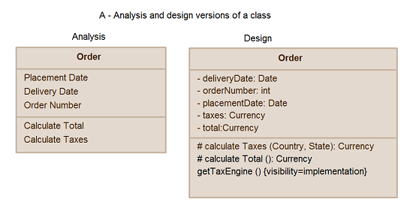
General Issues
Show visibility only on design models
Assess responsibilities on domain class diagrams
Highlight language-dependent visibility with property strings
Highlight types only on design models
Highlight types on analysis models only when the type is an actual requirement

Slide 6
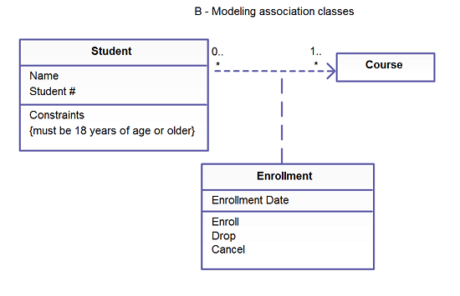
Association Classes
Model association classes on analysis diagrams.
The image that shows the “Modelling association classes” indicates the association classes that are depicted as class attached via a dashed line to an association
– the association line, the class, and the dashed line are considered one symbol in the UML.
- Do not name associations that have association classes.
- Center the dashed line of an association class.

Slide 7
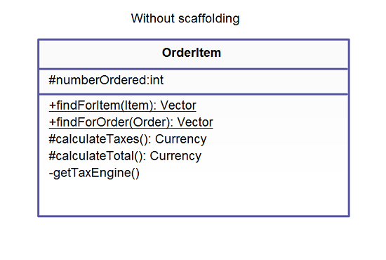
Class Style
A class is basically a template from which objects are created.
Classes define attributes, information that are relevant to their instances, operations, and functionality that the objects support.
Some of the more important guidelines pertinent to classes are listed in the next slide.
Scaffolding code refers to the attributes and operations required to use basic functionality within your classes, such as the code required to implement relationships with other classes.

Slide 8
Acknowledgement
Slides are based on Course Text Books:
Applying UMP and Patterns (An Introduction to Object-Oriented Analysis and Design and Iterative Development) : Craig Larman
UMP Distilled (A Brief Guide to the Standard Object Modeling Langauge) : Martin Fowler
Design Patterns (Elements of Reusable Object-Oriented Software) : Erich Gama | Richard Helm | Rapph Johnson | John Vlissides alias GoF.
http://creately.com/diagram-type/article/simple-guidelines-drawing-uml-class-diagrams

